Slide 1

Looping
Topics to be covered
Clock Synchronization
Logical Clocks
Mutual Exclusion
Election Algorithms
Distributed Transactions

Slide 2
Synchronization
Synchronization is coordination with respect to time, and refers to the ordering of events and execution of instructions in time
Entities in DSs often have to cooperate and synchronize to solve a given problem correctly
E.g., In a distributed file system, processes have to synchronize and cooperate such that two processes are not allowed to write to the same part of a file
Simultaneously access a shared resources , such as printer,
Agree on the ordering of events, such as whether message m1 from process P was sent before or after message m2 from process Q.

Slide 3
Need for Synchronization – An Example
Vehicle tracking in a City Surveillance System using a Distributed Sensor Network of Cameras

Slide 4
Need for Synchronization – An Example
Writing a file in a Distributed File System
Write data1 to file abc.txt at offset 0
Client A
Server
Client C
Distributed
File
abc.txt
Write data3 to file abc.txt at offset 1
Client B
Write data2 to file abc.txt at offset 1
If the distributed clients do not synchronize their write operations to the distributed file, then the data in the file can be corrupted

Slide 5
Clock Synchronization
Clock synchronization is a mechanism to synchronize the time of all the computers in a DS
It is often important to know when events occurred and in what order they occurred.
Need to know when a transaction occurs.
Online reservation system.
In a non-distributed system dealing with time is trivial as there is a single shared clock, where all processes see the same time.
In a distributed system, on the other hand, each computer has its own clock.
Because no clock is perfect each of these clocks has its own skew which causes clocks on different computers to drift and eventually become out of sync.

Slide 6
Clock synchronization
External and Internal Clock Synchronization.
External clock synchronization is the one in which an external reference clock is present. It is used as a reference and the nodes in the system can set and adjust their time accordingly.
Internal clock synchronization is the one in which each node shares its time with other nodes and all the nodes set and adjust their times accordingly.

Slide 7
Coordinated Universal Time (UTC)
All the computers are generally synchronized to a standard time called Coordinated Universal Time (UTC)
UTC is the primary time standard by which the world regulates clocks and time
Computer servers and online services with UTC receivers can be synchronized by satellite broadcasts
Many popular synchronization protocols in distributed systems use UTC as a reference time to synchronize clocks of computers

Slide 8
Tracking Time on a Computer
How does a computer keep track of its time?
Each computer has a hardware timer
The timer causes an interrupt ‘H’ times a second
The interrupt handler adds 1 to its Software Clock (C)
Issues with clocks on a computer
In practice, the hardware timer is imprecise
It does not interrupt ‘H’ times a second due to material imperfections of the hardware and temperature variations
The computer counts the time slower or faster than actual time
Loosely speaking, Clock Skew is the skew between:
The computer clock and the actual time (e.g., UTC)

Slide 9




Clock Skew
Clock Skew: Difference between two clocks at one point in time.
When the UTC time is t, let the clock on the computer have a time C(t)
Three types of clocks are possible
Perfect clock:
The timer ticks ‘H’ interrupts a second
dC/dt = 1
Fast clock:
The timer ticks more than ‘H’ interrupts a second
dC/dt > 1
Slow clock:
The timer ticks less than ‘H’ interrupts a second
dC/dt < 1
$$\frac{dC}{dt}>1$$
$$\frac{dC}{dt}=1$$
15
Perfect clock
Fast Clock
10
Clock time, C_{p}(t)
Slow Clock
7
$$\frac{dC}{dt}<1$$
0
10
UTC, t
UTC= Coordinated Universal Time

Slide 10



Clock Skew
Frequency of the clock is defined as the ratio of the number of seconds counted by the software clock for every UTC second
Frequency = dC/dt
Hence,
$$\frac{dC}{dt}>1$$
$$\frac{dC}{dt}=1$$
15
Perfect clock
Fast Clock
10
Clock time, C_{p}(t)
Slow Clock
7
$$\frac{dC}{dt}<1$$
0
10
UTC, t

Slide 11
Drifting of Clock
Synchronization techniques
External Synchronization : Synchronization with real time (external) clocks.
Mutual (Internal) Synchronization : For consistent view of time across all nodes of the system

Slide 12
Dealing with Drift
Assume we set computer to true time. (It is not good idea to set clock back.)
Illusion of time moving backwards can confuse message ordering and software development environments.
There should be go for gradual clock correction.
If fast: Make clock run slower until it synchronizes.
If slow: Make clock run faster until it synchronizes.
Operating System can change rate at which it requests interrupts.
if system requests interrupts every 14 msec but clock is too slow: request interrupts at 12 msec.
Software correction: Redefine the interval.

Slide 13
Clock synchronization algorithms
Clock synchronization algorithms: Centralized and Distributed.
Centralized is the one in which a time server is used as a reference.
The single time server propagates its time to the nodes and all the nodes adjust the time accordingly.
It is dependent on single time server so if that node fails, the whole system will lose synchronization.
Examples of centralized are- Berkeley Algorithm, Passive Time Server, Active Time Server etc.

Slide 14
Clock synchronization algorithms
Distributed is the one in which there is no centralized time server present.
Instead the nodes adjust their time by using their local time and then, taking the average of the differences of time with other nodes.
Distributed algorithms overcome the issue of centralized algorithms like the scalability and single point failure.
Examples of Distributed algorithms are – Global Averaging Algorithm, Localized Averaging Algorithm, NTP (Network time protocol) etc.

Slide 15
Cristian’s Algorithm
Flaviu Cristian (in 1989) provided an algorithm to synchronize networked computers with a time server
The basic idea:
Identify a network time server that has an accurate source for time (e.g., the time server has a UTC receiver)
All the clients contact the network time server for synchronization
However, the network delays incurred when the client contacts the time server results in outdated time
The algorithm estimates the network delays and compensates for it

Slide 16


Cristian’s Algorithm
Client Cli sends a request to Time Server Ser, time stamped its local clock time T1
Ser will record the time of receipt T2 according to its local clock
dTreq is network delay for request transmission
Server
Time Server Ser
T2
T3
T1
T1, T2, T3
Client
Client Cli
T1
T4
dTreq
dTres
Ser replies to Cli at its local time T3, piggybacking T1 and T2
Cli receives the reply at its local time T4
dTres is the network delay for response transmission
Now Cli has the information T1, T2, T3 and T4
Assuming that the transmission delay from Cli→Ser and Ser→Cli are the same
T2-T1 ≈ T4–T3

Slide 17
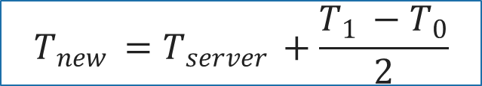

Cristian’s Algorithm
Note times:
Request sent: T0
Reply received: T1
Assume network delays are symmetric.
Client sets time to:
T_{server}
server
request
reply
client
T₀
T₁
time
$$\frac{T_{1 }−T_{0}}{2}$$
= estimated overhead in each direction
$$T_{new }=T_{server }+\frac{T_{1 }−T_{0}}{2}$$

Slide 18
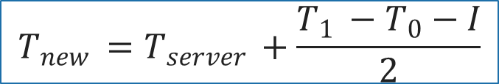
Cristian’s Algorithm
T_{server}
server
request
reply
client
T₀
T₁
time
I = server processing time
$$T_{new }=T_{server }+\frac{T_{1 }−T_{0}−I}{2}$$

Slide 19
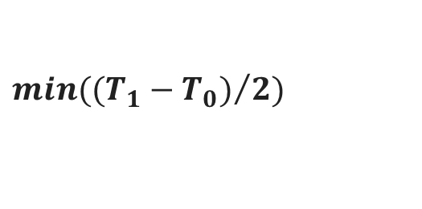
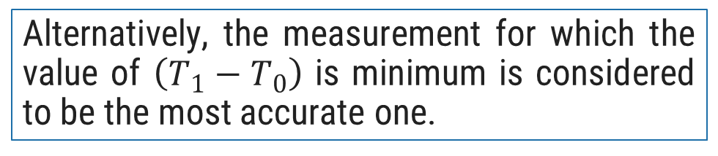
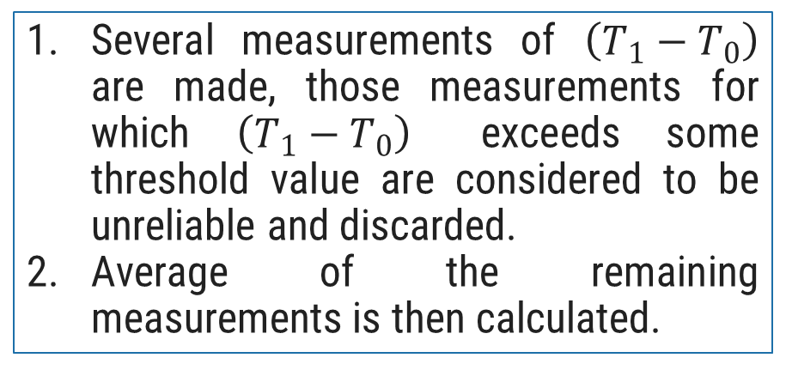

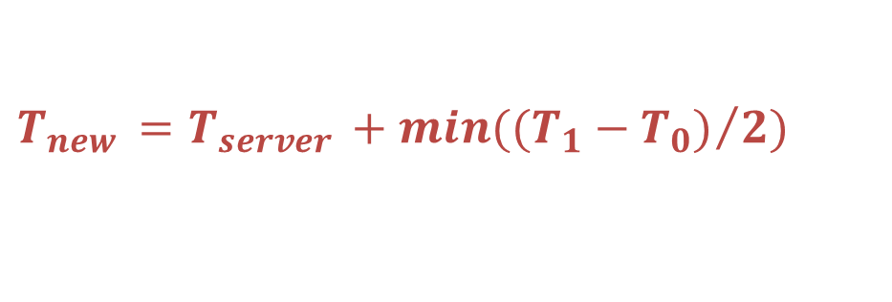
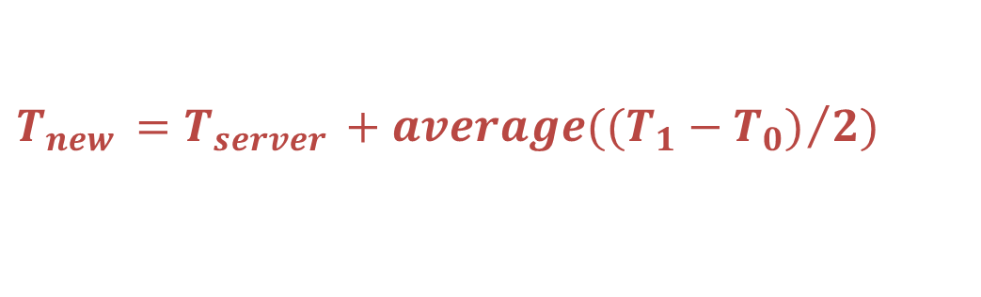
Cristian’s Algorithm
T_{server}
server
request
reply
client
T₀
T₁
time
Several measurements of $\left(T_{1}−T_{0}\right)$ are made, those measurements for which $\left(T_{1}−T_{0}\right)$ exceeds some threshold value are considered to be unreliable and discarded.
Average of the remaining measurements is then calculated.
Alternatively, the measurement for which the value of $\left(T_{1}−T_{0}\right)$ is minimum is considered to be the most accurate one.
$$min({(T_{1}−T_{0})}/2)$$
$$T_{new }=T_{server }+min({(T_{1}−T_{0})}/2)$$
$$average({(T_{1}−T_{0})}/2)$$
$$T_{new }=T_{server }+average({(T_{1}−T_{0})}/2)$$

Slide 20
Cristian’s Algorithm
Assumption about packet transmission delays:
Cristian’s algorithm assumes that the round-trip times for messages exchanged over the network are reasonably short
The algorithm assumes that the delay for the request and response are equal
Cristian’s algorithm is intended for synchronizing computers within intranets
A probabilistic approach for calculating delays:
There is no tight bound on the maximum drift between clocks of computers
Time server failure or faulty server clock:
Faulty clock on the time server leads to inaccurate clocks in the entire DS
Failure of the time server will render synchronization impossible

Slide 21
Berkeley Algorithm
A single time server can fail, blocking timekeeping
The Berkeley algorithm is a distributed algorithm for timekeeping
Assumes all machines have equally-accurate local clocks
Obtains average from participating computers and synchronizes clocks to that average
Time server periodically sends a message (“time=?”) to all computers in the group.
Each computer in the group sends its clock value to the server.
Server has prior knowledge of propagation time from node to server.
Time server readjusts the clock values of the reply messages using propagation time & then takes fault tolerant average.
The time server readjusts its own time & sends the adjustment (positive or negative) to each node.

Slide 22

Berkeley Algorithm
Approach:
A time server periodically (approx. once in 4 minutes) sends its time to all the computers and polls them for the time difference
The computers compute the time difference and then reply
The server computes an average time difference for each computer
The server commands all the computers to update their time (by gradual time synchronization)
At 3:00, the time daemon tells the other machines its time and asks for theirs.
They respond with how far ahead or behind the time daemon they are.
The time daemon computes the average and tells each machine how to adjust its clock
3:05
3:00
3:00
3:00
+0:00
+0:05
Time server
+0:15
-0:20
-0:10
+0:25
3:05
2:50
3:05
3:25

Slide 23
Logical Clocks
If two machines do not interact, there is no need to synchronize them.
What usually matters is that processes agree on the order in which events occur rather than the time at which they occurred
Many times, it is sufficient if processes agree on the order in which the events have occurred in a DS
For example, for a distributed make utility, it is sufficient to know if an input file was modified before or after its object file
Logical clocks are used to define an order of events without measuring the physical time at which the events occurred
Two types of logical clocks:
Lamport’s Logical Clock (or simply, Lamport’s Clock)
Vector Clock

Slide 24
Lamport’s Logical Clock
Lamport advocated maintaining logical clocks at the processes to keep track of the order of events
To synchronize logical clocks, Lamport defined a relation called “happened-before”
The expression a → b (reads as “a happened before b”) means that all entities in a DS agree that event a occurred before event b

Slide 25
The Happened-before Relation
The happened-before relation can be observed directly in two situations:
If a and b are events in the same process, and a occurs before b, then a→b is true
If a is an event of message m being sent by a process, and b is the event of m (i.e., the same message) being received by another process, then a→b is true
The happened-before relation is transitive
If a→b and b→c, then a→c

Slide 26
Properties of Logical Clock
From the happened-before relation, we can infer that:
If two events a and b occur within the same process and a → b, then C(a) and C(b) are assigned time values such that C(a) < C(b)
If a is the event of sending message m from one process (say P1), and b is the event of receiving m (i.e., the same message) at another process (say, P2), then:
The time values C1(a) and C2(b) are assigned in a way such that the two processes agree that C1(a) < C2(b)
The clock time C must always go forward (increasing), and never backward (decreasing)

Slide 27

Synchronizing Logical Clocks
Three processes P1, P2 and P3 running at different rates
If the processes communicate between each other, there might be discrepancies in agreeing on the event ordering
Ordering of sending and receiving messages m1 and m2 are correct
However, m3 and m4 violate the happened-before relationship
P1
P2
P3
0
0
0
6
m1
8
10
12
16
20
18
24
m2
30
24
32
x
40
30
40
50
36
x
48
m3
60
42
56
70
48
m4
64
80
54
72
90
60
80
100

Slide 28
Lamport’s Clock Algorithm
When a message is being sent:
Each message carries a timestamp according to the sender’s logical clock
When a message is received:
If the receiver logical clock is less than the message sending time in the packet, then adjust the receiver’s clock such that:
currentTime = timestamp + 1
P1
P2
P3
0
0
0
6
8
10
12
16
20
18
24
30
24
32
40
30
40
m3:60
50
36
48
60
42
56
m4:69
61
70
48
64
69
80
54
54
70
72
77
90
60
76
80
85
100

Slide 29
Implementation of Lamport’s Clock
Each process Pi maintains a local counter Ci and adjusts this counter according to the following rules:
For any two successive events that take place within Pi, Ci is incremented by 1
Each time a message m is sent by process Pi , m is assigned a timestamp ts(m) = Ci
Whenever a message m is received by a process Pj, Pj adjusts its local counter Cj to max(Cj, ts(m)) + 1

Slide 30
Implementation of Lamport’s Clock
Each process P_{i} maintains a local counter C_{i} and adjusts this counter according to the following rules:
For any two successive events that take place within P_{i}, C_{i} is incremented by 1
Each time a message m is sent by process P_{i} , m is assigned a timestamp ts(m) = C_{i}
Whenever a message m is received by a process P_{j}, P_{j} adjusts its local counter C_{j} to max(C_{j}, ts(m)) + 1
C₀=0
C₀=1
C₀=2
P₀
m:2
C₁=0
C₁=3
P₁
C₂=0
P₂

Slide 31
Vector Clocks
Lamport’s clock provides a basis for the more advanced vector clock algorithm
A vector clock for a system of N processes is an array of N integers
Every process P_{i} stores its own vector clock VC_{i}
Lamport’s time values for events are stored in VC_{i}
VC_{i} (a) is assigned to an event a
If VC_{i}(a) < VC_{i}(b), then we can infer that a→b (or more precisely, that event a causally preceded event b)

Slide 32
Updating Vector Clocks
Vector clocks are constructed as follows:
VC_{i}[i] is the number of events that have occurred at process P_{i} so far
VC_{i}[i] is the local logical clock at process P_{i}
If VC_{i}[j]= k, then P_{i} knows that k events have occurred at P_{j}
VC_{i}[j] is P_{i}’s knowledge of the local time at P_{j}
Increment VC_{i} whenever a new event occurs
Pass VC_{j} along with the message

Slide 33
Vector Clock Update Algorithm
Whenever there is a new event at P_{i}, increment VC_{i}[i]
When a process P_{i} sends a message m to P_{j}:
Increment VC_{i}[i]
Set m’s timestamp ts(m) to the vector VC_{i}
When message m is received process P_{j} :
VC_{j}[k] = max(VC_{j}[k], ts(m)[k]) ; (for all k)
Increment VC_{j}[j]
VC₀=(0,0,0)
VC₀=(1,0,0)
VC₀=(2,0,0)
P₀
m:(2,0,0)
VC₁=(0,0,0)
VC₁=(2,1,0)
P₁
VC₂=(0,0,0)
P₂

Slide 34
Inferring Events with Vector Clocks
Let a process P_{i} send a message m to P_{j} with timestamp ts(m), then:
Pj knows the number of events at the sender Pi that causally precede m
(ts(m)[i] – 1) denotes the number of events at P_{i}
Pj also knows the minimum number of events at other processes Pk that causally precede m
(ts(m)[k] – 1) denotes the minimum number of events at P_{k}
VC₀=(0,0,0)
VC₀=(1,0,0)
VC₀=(2,0,0)
P₀
m:(2,0,0)
VC₁=(0,0,0)
VC₁=(0,1,0)
VC₁=(2,2,0)
VC₁=(2,3,0)
P₁
VC₂=(0,0,0)
m’:(2,3,0)
VC₂=(2,3,1)
P₂

Slide 35
Enforcing Causal Communication
Assume that messages are multicast within a group of processes, P₀, P₁ and P₂
To enforce causally-ordered multicasting, the delivery of a message m sent from P_{i} to P_{j} can be delayed until the following two conditions are met:
ts(m)[i] = VCj[i] + 1 (Condition I)
ts(m)[k] <= VCj[k] for all k != i (Condition II)
Assuming that P_{i} only increments VC_{i}[i] upon sending m and adjusts VC_{i}[k] to max{VC_{i}[k], ts(m)[k]} for each k upon receiving a message m’
P₀
VC₀=(0,0,0)
VC₀=(1,0,0)
VC₀=(1,1,0)
m:(1,0,0)
m:(1,1,0)
P₁
VC₁=(0,0,0)
VC₁=(1,0,0)
VC₁=(1,1,0)
P₂
VC₂=(0,0,0)
VC₂=(1,0,0)
VC₂=(1,1,0)
VC₂=(1,1,0)
Condition II does not hold ➔ Delay delivery

Slide 36
Mutual Exclusion
In single-processor systems, critical regions are protected using semaphores, monitors, and similar constructs.
In distributed systems, since there is no shared memory, these methods cannot be used.
Mutual exclusion: Concurrent access of processes to a shared resource or data is executed in mutually exclusive manner.
Only one process is allowed to execute the critical section (CS) at any given time.
In a distributed system, shared variables (semaphores) or a local kernel cannot be used to implement mutual exclusion.
Message passing is the sole means for implementing distributed mutual exclusion

Slide 37
Critical Section
The sections of a program that need exclusive access toshared resources are referred to as critical sections.
Mutual Exclusion : Prevent processes from executing concurrently with their associated critical section.
Requirement :
Mutual exclusion: At anytime only one process should access the resource.
A process can get another resource first releasing its own.
No starvation: if every process that is granted the resource eventually release it, every request must be eventually granted.

Slide 38
Types of Distributed Mutual Exclusion
Mutual exclusion algorithms are classified into two categories
Request to access
1. Permission-based Approaches
A process, which wants to access a shared resource, requests the permission from one or more coordinators
2. Token-based Approaches
Each shared resource has a token
Token is circulated among all the processes
A process can access the resource if it has the token
Coordinator
C1
Client 1
Grant
Server
P1
Resource
Access
Server
Resource
Access
Access
Access
Client 1
Client 2
Client 3
P1
P2
P3
Token
Token
Token

Slide 39
Permission-based Approaches
There are two types of permission-based mutual exclusion algorithms
Centralized Algorithms
Decentralized Algorithms

Slide 40
Centralized Mutual Exclusion Algorithm
One process is elected as a coordinator (C) for a shared resource
Coordinator maintains a Queue of access requests
Whenever a process wants to access the resource, it sends a request message to the coordinator to access the resource
When the coordinator receives the request:
If no other process is currently accessing the resource, it grants the permission to the process by sending a “grant” message
If another process is accessing the resource, the coordinator queues the request, and does not reply to the request
The process in action releases the exclusive access after accessing the resource
Afterwards, the coordinator sends the “grant” message to the next process in the queue
P0
P1
P2
Rel
Grant
Access
Req
Grant
Access
Req
Resource
C
P2
P1
Queue

Slide 41
Centralized Mutual Exclusion Algorithm
Coordinator coordinates entry to critical section.
Allows only one process to enter critical section.
Ensures no starvation as uses first come, first served policy.
Simple implementation
Three messages per critical section
Request
Reply
Release
Single point of failure & performance bottleneck.

Slide 42








Centralized Mutual Exclusion Algorithm
Process P₂ then asks permission to enter the same critical region. The coordinator does not reply.
$$P_{2}$$
P_{c} sends back a reply message granting permission to P₁ as critical section is free.
On receiving release message, P_{c} takes the first request from the queue and sends a reply message.
6 Reply
3 Request
7 Release
5 Release
9 Release
$$P_{1}$$
2 Reply
$$P_{C}$$
8 Reply
$$P_{3}$$
1 Request
4 Request
Process P₁ wants to enter a critical section for which it sends a request to P_{c}
When process P₁ exits the critical section sends a release message to P_{c}
Initial state
$$P_{2}$$
Status after 3
$$P_{3}$$
$$P_{2}$$
Status after 4
$$P_{3}$$
Status after 5
Status after 7

Slide 43
A Centralized Algorithm – Advantages and Disadvantages
Advantages
Flexibility : Blocking versus non-blocking requests
The coordinator can block the requesting process until the resource is free
Or, the coordinator can send a “permission-denied” message back to the process
Simplicity : The algorithm guarantees mutual exclusion, and is simple to implement
Disadvantages
Fault-Tolerance Deficiency : Centralized algorithm is vulnerable to a single-point of failure (at coordinator)
If processes normally block after making a request, they cannot distinguish a dead coordinator from ‘‘permission denied’’ since no message comes back.
Performance Bottleneck : In a large-scale system, single coordinator can be overwhelmed with requests

Slide 44
Distributed Mutual Exclusion Algorithm
When a process wants to enter the CS (critical section) , it sends a request message to all other processes, and when it receives reply from all processes, then only it is allowed to enter the CS.
The request message contains following information:
Process identifier
Name of CS
Unique time stamp generated by process for request message

Slide 45
Distributed Mutual Exclusion Algorithm
The decision whether receiving process replies immediately to a request message or defers its reply is based on three cases:
If receiver process is in its critical section, then it defers its reply.
If receiver process does not want to enter its critical section, then it immediately sends a reply.
If receiver process itself is waiting to enter critical section, then it compares its own request timestamp with the timestamp in request message
If its own request timestamp is greater than timestamp in request message, then it sends a reply immediately.
Otherwise, the reply is deferred.

Slide 46




Distributed Mutual Exclusion Algorithm
TS=6
OK
P₁
P₂
P₁
P₂
$$P_{1}$$
TS=4
Defers sending a reply to P₁
TS=6
TS=4
OK
OK
TS=4
TS=6
P₄
P₃
$$P_{2}$$
$$P_{1}$$
P₄
P₃
Already in CS
Defers sending a reply to P₁ and P₂
(a)
(b)
P₁
P₁
OK
Exits CS
P₂
$$P_{1}$$
P₂
Enters CS
Enters CS
OK
OK
P₄
P₃
P₄
P₃
Exits CS
(c)
(d)

Slide 47
A Token Ring Algorithm
With a token ring algorithm:
Each resource is associated with a token
The token is circulated among the processes
The process with the token can access the resource
How is the token circulated among processes?
All processes form a logical ring where each process knows its next process
One process is given the token to access the resource
The process with the token has the right to access the resource
If the process has finished accessing the resource OR does not want to access the resource:
It passes the token to the next process in the ring
Access
T
Resource
P0
P1
P2
P3
P4
P5
P6
P7
T
T
T
T
T
T
T

Slide 48
Failure in Token Ring Algorithm
Two types of failure can occur:
Process failure
Lost token

Slide 49
Failure in Token Ring Algorithm
Process failure: A process failure in the system causes the logical ring to break.
Requires detection of failed process & dynamic reconfiguration of logical ring.
Process receiving token sends back acknowledgement to neighbor.
When a process detects failure of neighbor, it removes failed process by skipping it & passing token to process after it.
When a process becomes alive after recovery, It informs the neighbour previous to it so that it gets the token during the next round of circulation.

Slide 50
Failure in Token Ring Algorithm
Lost token: If the token is lost, a new token must be generated.
Must have mechanism to detect & regenerate token.
Designate process as monitor. Monitor periodically circulates “who has token”.
Owner of token writes its process identifier in message & passes on.
On receipt of message, monitor checks process identifier field. If empty generate new token & passes it.
Multiple monitors can be used.

Slide 51
Comparison of Mutual Exclusion Algorithms
Number of messages
Delay before a process
required for a process
Algorithm
can access the resource
Problems
to access and release
(in message times)
the shared resource
3
2
•
Coordinator crashes
Centralized
•
Crash of any process
-
2(n
1)
2(n
1)
Decentralized
-
•
Large
number of messages
•
Token may be lost
1 to ∞
(n
Token
Ring
0
to
-
1)
•
Ring can cease to exist since
processes crash

Slide 52
Need for a Coordinator
Many algorithms used in distributed systems require a coordinator
For example, see the centralized mutual exclusion algorithm.
In general, all processes in the distributed system are equally suitable for the role
Election algorithms are designed to choose a coordinator.

Slide 53

Election in Distributed Systems
Many distributed algorithms require one process to act as a coordinator
Typically, it does not matter which process is elected as the coordinator
Coordinator
Time server
C1
Client 1
P1
Server
Resource
Berkeley Clock Synchronization Algorithm
A Centralized Mutual Exclusion Algorithm

Slide 54
Election Algorithms
What is Election?
In a group of processes, elect a leader to undertake special tasks.
What happens when a leader fails (crashes)
Some process detects this
Then what?
Any process can serve as coordinator
Any process can “call an election” (initiate the algorithm to choose a new coordinator).
There is no harm (other than extra message traffic) in having multiple concurrent elections.
Elections may be needed when the system is initialized, or if the coordinator crashes or retires.
An algorithm for choosing a unique process to play a particular role.

Slide 55
Assumptions
Any process can call for an election.
A process can call for at most one election at a time.
Every process/site has a unique ID; e.g.
The network address
A process number
Every process in the system should know the values in the set of ID numbers
The process with the highest ID number will be the new coordinator.
Multiple processes can call an election simultaneously.
All of them together must yield a single leader only
The result of an election should not depend on which process calls for it.
Messages are eventually delivered.

Slide 56
Election Algorithms
Bully Algorithm
Ring Algorithm

Slide 57
Bully Algorithm
Bully algorithm specifies the process with the highest identifier will be the coordinator of the group. It works as follows:
When a process p detects that the coordinator is not responding to requests, it initiates an election:
p sends an election message to all processes with higher numbers.
If nobody responds, then p wins and takes over.
If one of the processes answers, then p’s job is done.
If a process receives an election message from a lower-numbered process at any time, it:
sends an OK message back.
holds an election (unless its already holding one).
A process announces its victory by sending all processes a message telling them that it is the new coordinator.
If a process that has been down recovers, it holds an election.

Slide 58
Bully Algorithm
A process (say, P_{i}) initiates the election algorithm when it notices that the existing coordinator is not responding
Process P_{i} calls for an election as follows:
Coordinator
1
5
6
3
7
0
4
2
P_{i} sends an “Election” message to all processes with higher process IDs
When process P_{j} with j>i receives the message, it responds with a “Take-over” message. P_{i} no more contests in the election
Process P_{j} re-initiates another call for election. Steps 1 and 2 continue
If no one responds, P_{i} wins the election. P_{i} sends “Coordinator” message to every process
Election
Take-Over
Take-Over
Election
Election
Take-over
Election
Election
Election
X

Slide 59
Ring Algorithm
The ring algorithm assumes that the processes are arranged in a logical ring and each process is knowing the order of the ring of processes.
If any process detects failure, it constructs an election message with its process ID and sends it to its neighbor.
If the neighbor is down, the process skips over it and sends the message to the next process in the ring.
This process is repeated until a running process is located.
At each step, the process adds its own process ID to the list in the message and sends the message to its living neighbor.
Eventually, the election message comes back to the process that started it.
The process then picks either the highest or lowest process ID in the list and sends out a message to the group informing them of the new coordinator.

Slide 60
Ring Algorithm
This algorithm is generally used in a ring topology
When a process P_{i} detects that the coordinator has crashed, it initiates the election algorithm
1
2
3
4
5
6
7
0
E: 5,6,0
E: 5,6,0,1
P_{i} builds an “Election” message (E), and sends it to its next node. It inserts its ID into the Election message
When process P_{j} receives the message, it appends its ID and forwards the message
If the next node has crashed, P_{j} finds the next alive node
When the message gets back to P_{i}:
P_{i} elects the process with the highest ID as coordinator
P_{i} changes the message type to a “Coordination” message (C) and triggers its circulation in the ring
C: 6
C: 6
E: 5,6,0,1,2
C: 6
X
E: 5,6
C: 6
E: 5,6,0,1,2,3
C: 6
E: 5,6,0,1,2,3,4
C: 6
E: 5
C: 6

Slide 61
Comparison of Election Algorithms
Algorithm | Number of Messages for Electing a Coordinator | Problems
Bully Algorithm
Ring Algorithm
O(n²)
Large message overhead
An overlay ring topology is necessary
2n
Assume that: n = Number of processes in the distributed system

Slide 62
Global State
“The global state of a distributed computation is the set of local states of all individual processes involved in the computation plus the state of the communication channels.”
Knowing the global state of distributed system may be useful for many reasons.
For example:
How to know that system is dealing with deadlock or distributed computation has correctly terminated?

Slide 63
Global State
Determining global properties: often difficult, but essential for some applications.
Distributed garbage collection:
Do any references exist to a given object?: Collects remote server objects that are no longer referenced by any client in the network
Distributed deadlock detection:
Do processes wait in a cycle for each other?
Distributed algorithm termination detection:
Did a set of processes finish all activity? (Consider messages in transit)
All these properties are stable: once they occur, they do not disappear without outside intervention.

Slide 64
Analysis of GLOBAL STATE (Distributed Snapshot)
A distributed snapshot reflects a state in which the distributed system might have been.
A snapshot reflects a consistent global state
Example: if we have recorded that a process Q has received a message from another process P, then we should also recorded that process P has actually sent that message
Otherwise, a snapshot will contain the recording of messages that have been received but never sent,
Which indicate the inconsistent global state
The reverse condition (P has sent a message that Q has not yet received) is allowed

Slide 65
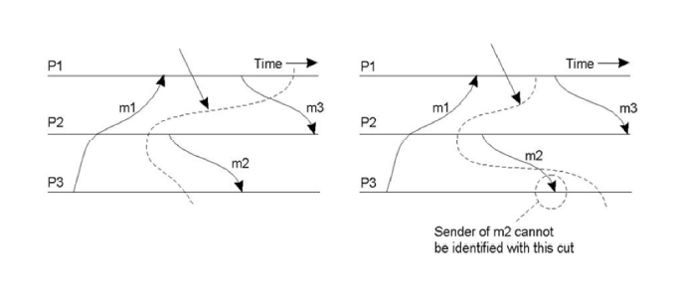
Cut
Global state can be graphically represented by cut
It represents the last event recorded for each process
2 types of cut: consistent, inconsistent
Consistent cut: all recorded message receipts have a corresponding recorded send event
Inconsistent cut: no corresponding send event

Slide 66
Transactions
Transaction:
Comes from the database world: the concept of a transaction originates from the database community as a mechanism to maintain the consistency of databases.
Defines a sequence of operations
A single transaction contains a collection of data accesses/modifications.
The collection is treated as an “atomic operation” – either all the collections are complete, or none of them do.
Mechanisms exist for the system to revert to a previously “good state” whenever a transaction prematurely aborts.

Slide 67
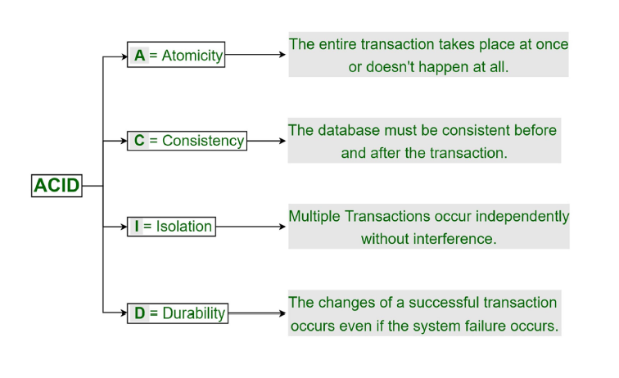
ACID Property

Slide 68
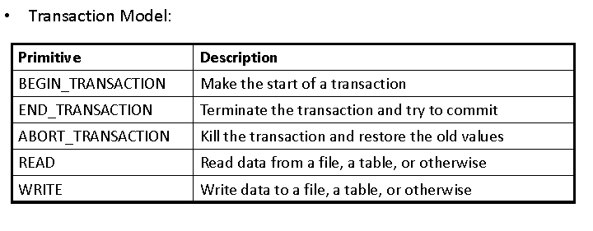
Transactions

Slide 69
Classification Of Transactions
Flat Transaction: this is the model that we have looked at so far. The sequence of operations that satisfies ACID
Disadvantage: too rigid…. Partial results cannot be committed.
Nested Transaction: hierarchy of transactions. A main, parent transaction spawns child sub-transactions to do the real work.
Disadvantage: problems result when a sub-transaction commits and then the parent aborts the main transaction.
Distributed Transaction: this is sub-transactions operating on distributed data stores.
Disadvantage: complex mechanisms required to lock the distributed data, as well as commit the entire transaction

Slide 70
Flat Transactions
Simple
Failure --- all changes undone
BeginTransaction
accountA -= 100;
accountB += 50;
accountC += 25;
accountD += 25;
EndTransaction

Slide 71
Nested Transaction
Subdivide a complex transaction into many smaller subtransactions
As a result, if a single sub-transaction fails, the work that went into others is not necessary wasted
Example:
Booking a flight
A B
B C
C D
What to do?
Abort whole transaction
Partially commit transaction and try alternative for aborted part
Commit non aborted parts of transaction

Slide 72
Nested Transaction
Subtransactions and parent transactions
Parent transaction may commit even if some subtransactions aborted
Parent transaction aborts all subtransactions abort

Slide 73
Nested Transaction
Subtransactions:
Subtransaction can abort any time
Subtransaction cannot commit until parent ready to commit
Subtransaction either aborts or commits provisionally
Provisionally committed subtransaction reports provisional commit list, containing all its provisionally committed subtransactions, to parent
On abort, all subtransactions in that list are aborted.

Slide 74
Transaction Implementation
Private Workspace:
Perform all tentative operations on a shadow copy of the server state
Atomically swap with main copy on Commit
Discard shadow on Abort.

Slide 75
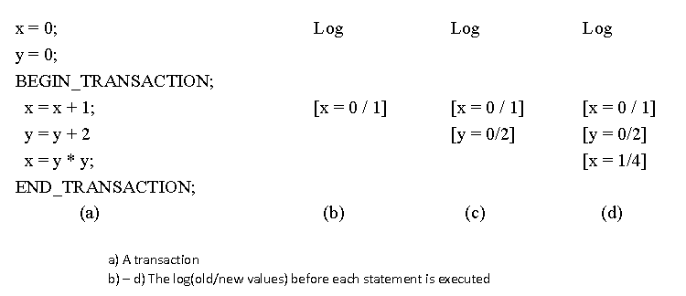
Transaction Implementation
Writeahead Log:
Actual files get modified
Before any block is changed, a record is written to a log
Log is reverted when a transaction Aborts

Slide 76
Concurrency Control
It is often necessary to allow transactions to occur simultaneously (for example, to allow multiple travel agents to simultaneously reserve seats on the same flight, Clients accessing bank accounts).
Due to the consistency and isolation properties of transactions, concurrent transaction must not be allowed to interfere with each other.
Concurrency control algorithms for transactions guarantee that multiple transactions can be executed simultaneously while providing a result that is the same as if they were executed one after another.(consistent state)

Slide 77
Concurrency control
Concurrency control is best understood in terms of three different managers
(1) Data manager – performs actual read and write operations
(2) Scheduler – mainly responsible to control Concurrency in such a way that isolation and consistency are met
(3) Transaction manager – mainly responsible for guaranteeing atomicity of transactions

Slide 78
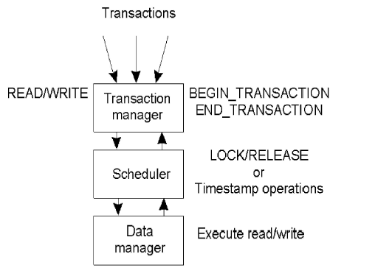

Slide 79
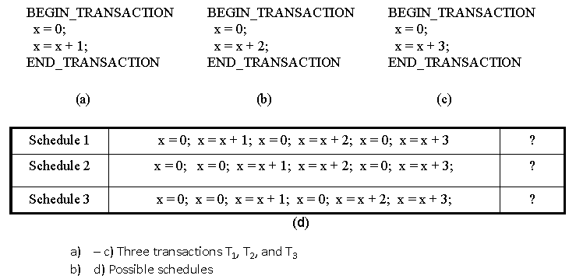
Serializability
Main purpose of concurrency control algorithms is to guarantee that multiple transactions can be executed simultaneously while still being isolated at the same time
The final result should be the same as if the transactions were executed one after other in some specific order
Which of the following schedules are serialized? A->b->c, order is different…c->b->a

Slide 80
Dealing with Concurrency
Pessimistic vs Optimistic concurrency control approaches
Pessimistic : if something can go wrong, it will.
Operations are synchronized/ conflicts are resolved before they carried out/happen.
Optimistic – based on idea: nothing will go wrong.
Synchronization takes place at the end of transaction. If there is conflict, one or more transactions are forced to abort!
Locking (mutual exclusion) - pessimistic
Timestamp Ordering (explicit ordering)- pessimistic
Optimistic Control

Slide 81
Locking
Pessimistic approach: prevent illegal schedules
Operations are synchronized before they are carried out
Process requests the scheduler to grant a lock for data item and when no longer needed it is requested to release a lock.
The scheduler is responsible for granting and releasing locks in such a way that legal schedules are produced.
Ensures that only valid schedules result

Slide 82
Basic Two Phase Locking (2PL)
In two-phase locking(2PL), the scheduler first acquires all the locks in needs during the growing phase and then releases them during shrinking phase with following 3 rules:
(1) When the scheduler receives an operation oper(T,x) from the transaction manager, it tests whether that operation conflicts with any other operation for which it already granted a lock. If there is a conflict, oper(T,x) is delayed and hence transaction T also. If no conflict, the scheduler grants a lock for data item x, and passes the operation to the data manager.
(2) The scheduler will never release a lock for data item x, until the data manager acknowledges it has performed the operation for which the lock was set.
(3) Once the scheduler has released a lock on behalf of T, it will never grant another lock on behalf of T, no matter for which data item T is requesting a lock.

Slide 83
Basic Two Phase Locking (2PL)
Conservative/Static 2PL – lock all the items it accesses before the transaction begins execution
Problems With Locking:
Cascaded Aborts: If a transaction (T1) reads the results of a write of another transaction (T2) that is subsequently aborted, then the first transaction (T1) will also have to be aborted.

Slide 84
Timestamp Ordering
Each transaction Ti is assigned with unique timestamp (ts(Ti)) when it starts.
Each data item has two timestamps:
read timestamp: tsRD(x) - the timestamp of the last read x
write timestamp: tsWR(x) - the timestamp of the last committed write x
Timestamp ordering rule:
write request only valid if TS(W) > tsWR and TS(W) ≥ tsRD
read request only valid if TS(R) > tsWR

Slide 85
Optimistic Control
Assume that no conflicts will occur.
Detect & resolve conflicts at commit time
A transaction is split into three phases:
Working
Validation
Update
In the working phase operations are carried out on shadow copies with no attempt to detect or order conflicting operations.
In the validation phase the scheduler attempts to detect conflicts with other transactions that were in progress during the working phase. If conflicts are detected then one of the conflicting transactions is aborted.
In the update phase, assuming that the transaction was not aborted, all the updates made on the shadow copy are made permanent.

Slide 86
Distributed Transactions
In distributed system, a single transaction will,in general, involve several servers:
transaction may require several services,
transaction involves files stored on different servers
All servers must agree to Commit or Abort, and do this atomically.

Slide 87
Distributed Flat Transaction

Slide 88
Distributed Nested Transaction

Slide 89
Distributed Concurrency Control

Slide 90
Distributed Locking
Distributed 2PL:
Data can be replicated
Scheduler on each machine responsible for locking own data
Read lock: contact any replica
Write lock: contact all replicas

Slide 91
Distributed Transaction Organization
Each distributed transaction has a coordinator, the server handling the initial BeginTransaction call
Coordinator maintains a list of workers, i.e. other servers involved in the transaction
Each worker needs to know coordinator
Coordinator is responsible for ensuring that whole transaction is atomically committed or aborted
Require a distributed commit protocol.

Slide 92
Distributed Atomic Commit – 2PC Protocol
Transaction may only be able to commit when all workers are ready to commit
Distributed commit requires at least two phases:
Voting phase: all workers vote on commit, coordinator then decides whether to commit or abort.
Completion phase: all workers commit or abort according to decision.

Slide 93
The Protocol
(Begin Phase 1) The coordinator sends a Request-to-Prepare message to each participant
The coordinator waits for all participants to vote
Each participant
votes Prepared if it’s ready to commit
may vote No for any reason
(Begin Phase 2) If coordinator receives Prepared from all participants, it decides to commit. Otherwise, it decides to abort.
The coordinator sends its decision to all participants (i.e. Commit or Abort)
Participants acknowledge receipt of Commit or Abort by replying Done.

Slide 94
Failures can be due to:
server failures/hosts:
If a host fails in the 2PC protocol, then, after being restarted, it aborts all transactions.
restarting worker aborts all transactions
Failure of communication channels/network:
coordinator aborts after timeout.

